Slide 1
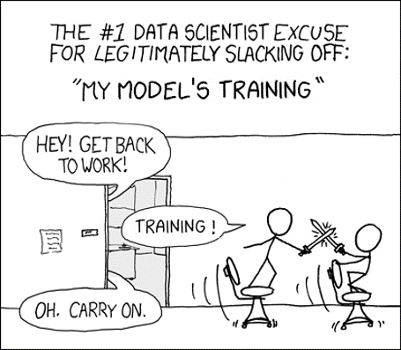

Deep neural networks
Xkdc
Machine Learning Methods for Biomedical Data (D012554)

Slide 2

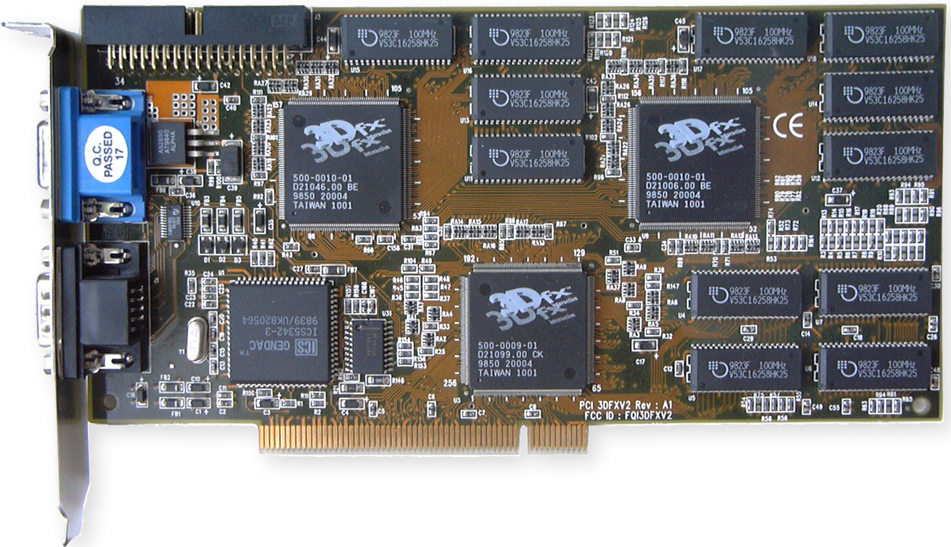
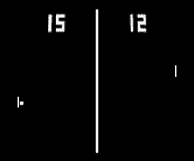
Graphical Processing Unit (GPU)
1998, 0.002 TFlops
Machine Learning Methods for Biomedical Data (D012554)
Notes:
Also convex!

Slide 3
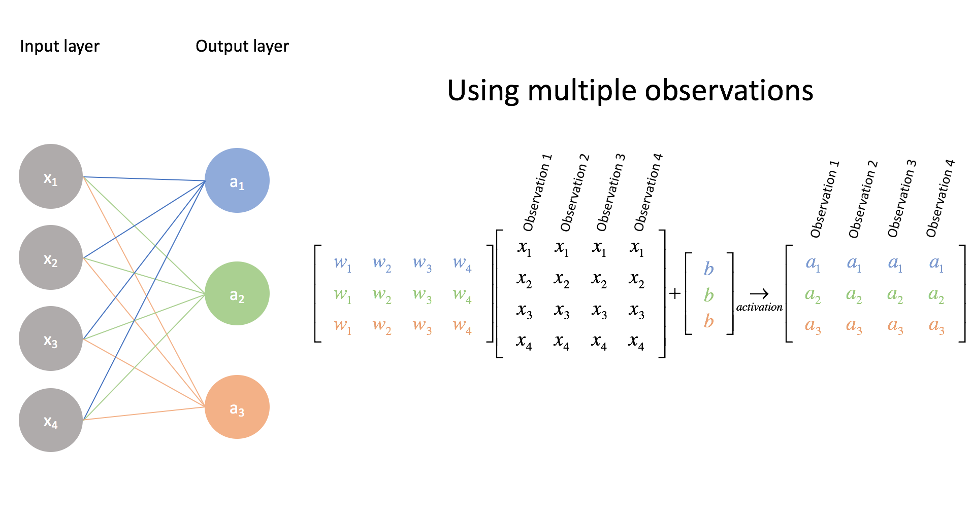
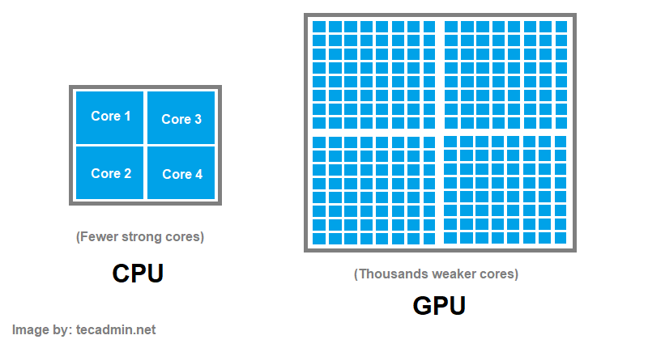
GPU vs CPU
A CPU (Central Processing Unit) is optimized for sequential processing and complex tasks, featuring a few powerful cores.
A GPU (Graphics Processing Unit) is designed for parallelism, with thousands of smaller cores handling many simple operations simultaneously.
Machine Learning Methods for Biomedical Data (D012554)
Notes:
Also convex!

Slide 4
GPU vs CPU
A CPU (Central Processing Unit) is optimized for sequential processing and complex tasks, featuring a few powerful cores.
A GPU (Graphics Processing Unit) is designed for parallelism, with thousands of smaller cores handling many simple operations simultaneously.
(BATCH)
Machine Learning Methods for Biomedical Data (D012554)
Notes:
Also convex!

Slide 5
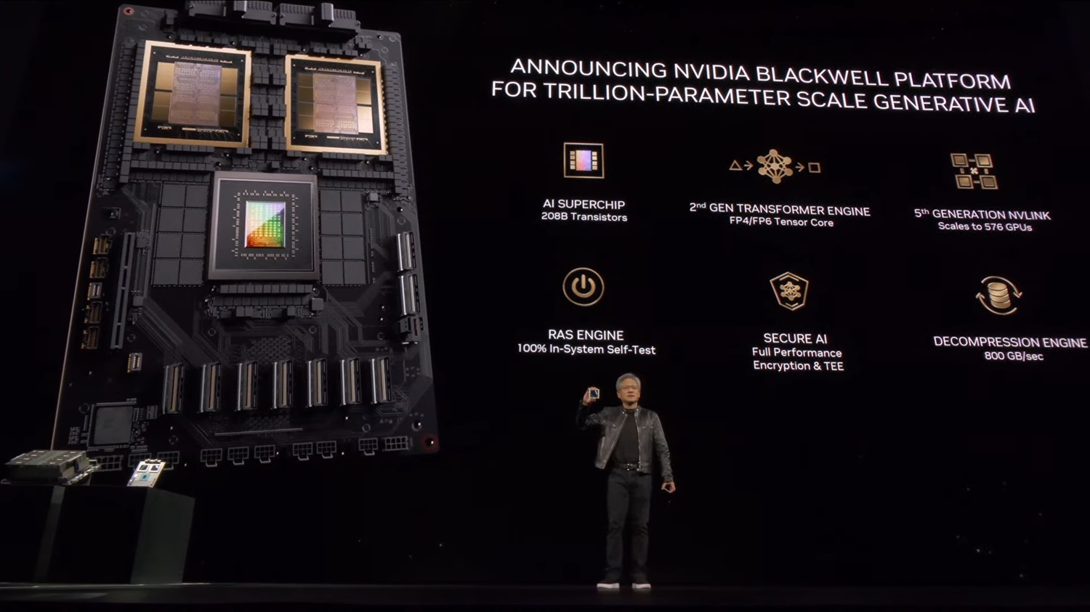
Machine Learning Methods for Biomedical Data (D012554)
Notes:
Jensen Huang

Slide 6
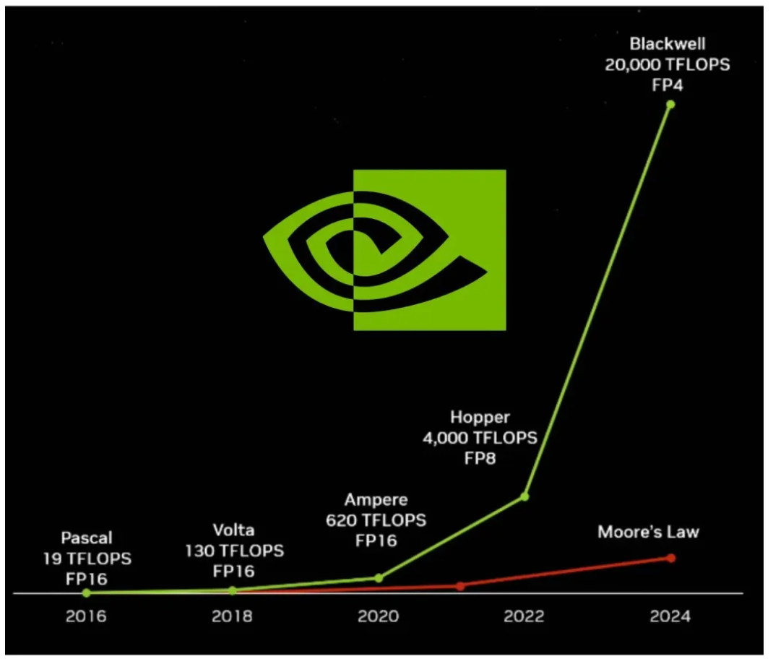
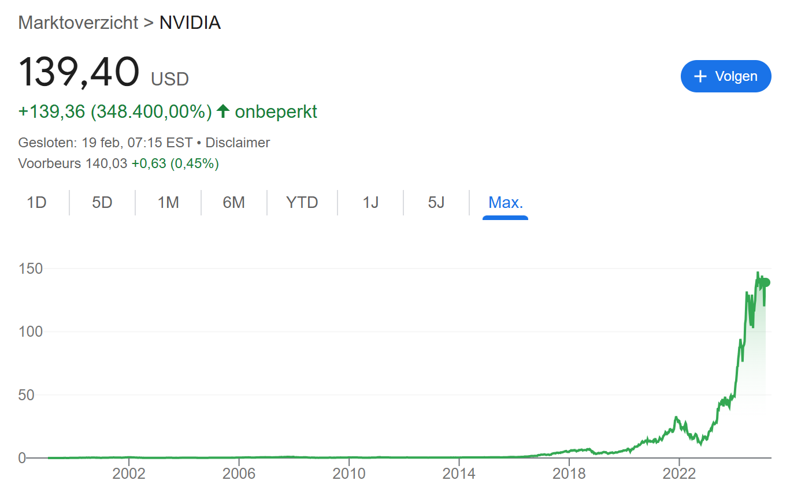
Graphical Processing Unit (GPU)
Machine Learning Methods for Biomedical Data (D012554)
Notes:
Also convex!

Slide 7
Deep learning: what it really is (to my best understanding)
Deep learning models distill vast amounts of information into relatively small, high-dimensional vector embeddings that efficiently capture diverse concepts, facts, and nuances.
These embeddings aren’t merely compressed data, they encapsulate intricate relationships and latent features, enabling models to recognize and generalize patterns across different domains.
By leveraging superposition, deep learning allows multiple patterns or concepts to coexist within a single vector, maximizing representational capacity without a proportional increase in size.
Machine Learning Methods for Biomedical Data (D012554)
Notes:
Also convex!

Slide 8
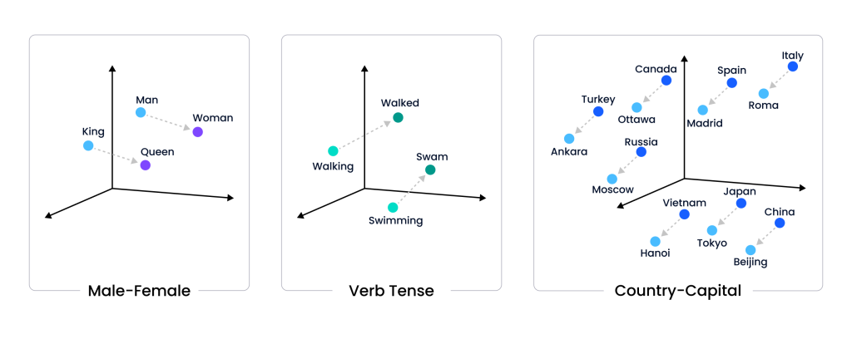
Deep learning: what it really is (to my best understanding)
Machine Learning Methods for Biomedical Data (D012554)
Notes:
Also convex!

Slide 9
Neural network
Neuron activation as logistic regression: Each neuron in a neural network functions like a logistic regression unit, applying a weighted sum of inputs followed by a nonlinear activation function (often a sigmoid in early networks).
Multi-layer extension: A neural network extends logistic regression by stacking multiple layers of these units, allowing it to model complex, non-linear relationships beyond what a single logistic regression model can achieve.
Backpropagation as gradient descent: Training a neural network uses backpropagation, which is essentially gradient descent applied to multiple layers of logistic regression units, adjusting weights to minimize error across the entire network.
Machine Learning Methods for Biomedical Data (D012554)
Notes:
Also convex!

Slide 10
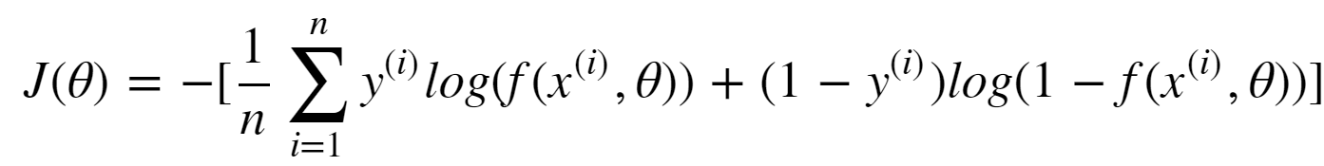
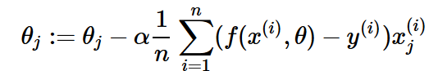
Logistic regression
Fit a logistic model
such that the cost function
is minimised with the gradient descent algorithm:
Machine Learning Methods for Biomedical Data (D012554)
Notes:
Also convex!

Slide 11
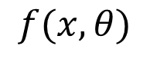
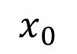
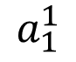
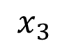
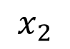
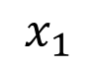
Neural network
We can visualize a logistic regression model as follows:
$$x_{0}$$
$$x_{1}$$
$$a_{1}^{1}$$
$$f(x,θ)$$
$$x_{2}$$
$$x_{3}$$
Machine Learning Methods for Biomedical Data (D012554)
Notes:
Also convex!

Slide 12
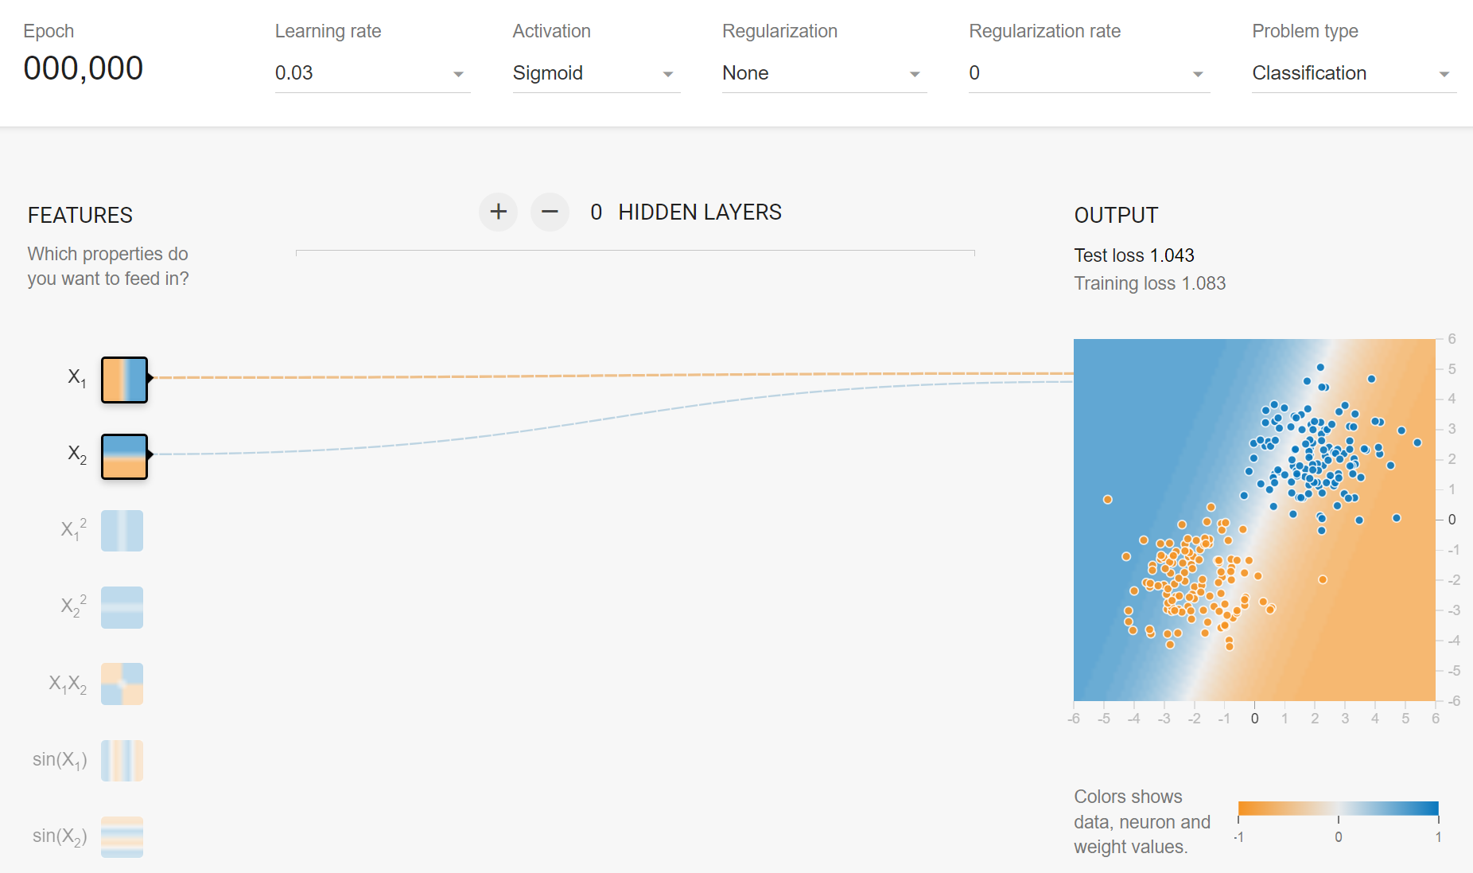
Neural network
We can visualize a logistic regression model as follows (ctrl-click image):
Machine Learning Methods for Biomedical Data (D012554)
Notes:
Also convex!

Slide 13
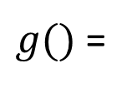
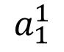
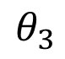
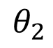
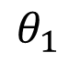
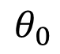
Neural network
We can visualize a logistic regression model as follows:
$$x_{0}$$
$$θ_{0}$$
$$x_{1}$$
$$θ_{1}$$
$g()$ =
$$a_{1}^{1}$$
$$f(x,θ)$$
$$θ_{2}$$
$$x_{2}$$
$$θ_{3}$$
$$x_{3}$$
Machine Learning Methods for Biomedical Data (D012554)
Notes:
Also convex!

Slide 14
Neural network
We can visualize a logistic regression model as follows:
$$x_{0}$$
$$x_{1}$$
$$a_{1}^{1}$$
$$f(x,θ)$$
$$x_{2}$$
$$x_{3}$$
Machine Learning Methods for Biomedical Data (D012554)
Notes:
Also convex!

Slide 15
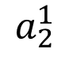
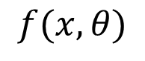
Neural network
A neural network is an architecture that consists of logistic models:
An additional logistic model is added as a node in the model’s first (hidden) layer.
$$x_{0}$$
$$x_{1}$$
$$a_{1}^{1}$$
$$x_{2}$$
$$a_{2}^{1}$$
$$f(x,θ)$$
$$x_{3}$$
Machine Learning Methods for Biomedical Data (D012554)
Notes:
Also convex!

Slide 16
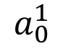
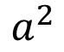
Neural network
A neural network is an architecture that consists of logistic models:
An additional logistic model is added as a node in the model’s first (hidden) layer, followed by a logistic regression model in the output layer.
$$x_{0}$$
$$a_{0}^{1}$$
$$x_{1}$$
$$a_{1}^{1}$$
$$x_{2}$$
$$a_{2}^{1}$$
$$a^{2}$$
$$f(x,θ)$$
$$x_{3}$$
Machine Learning Methods for Biomedical Data (D012554)
Notes:
Also convex!

Slide 17
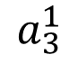
Neural network
A neural network is an architecture that consists of logistic models:
More additional logistic models can be added as nodes in the model’s first (hidden) layer, followed by a logistic regression model in the output layer.
$$x_{0}$$
$$a_{0}^{1}$$
$$x_{1}$$
$$a_{1}^{1}$$
$$x_{2}$$
$$a_{2}^{1}$$
$$a^{2}$$
$$f(x,θ)$$
$$x_{3}$$
$$a_{3}^{1}$$
…
Machine Learning Methods for Biomedical Data (D012554)
Notes:
Also convex!

Slide 18
Non-linearity: activation function
An activation function determines whether a neuron should be activated by introducing non-linearity into the network, allowing it to learn complex patterns.
Common activation functions include ReLU (Rectified Linear Unit) for efficiency, Sigmoid for probabilities, and Tanh for zero-centered outputs.
Choosing the right activation function impacts model performance, affecting convergence speed, vanishing/exploding gradients, and overall network accuracy.
Machine Learning Methods for Biomedical Data (D012554)
Notes:
Also convex!

Slide 19
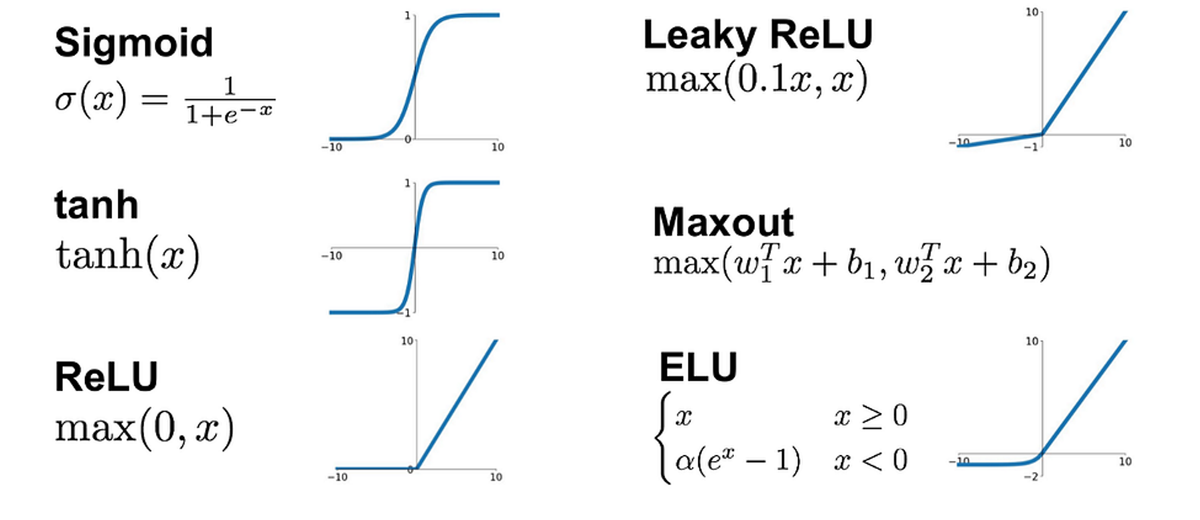
Non-linearity: activation function
Machine Learning Methods for Biomedical Data (D012554)
Notes:
Also convex!

Slide 20
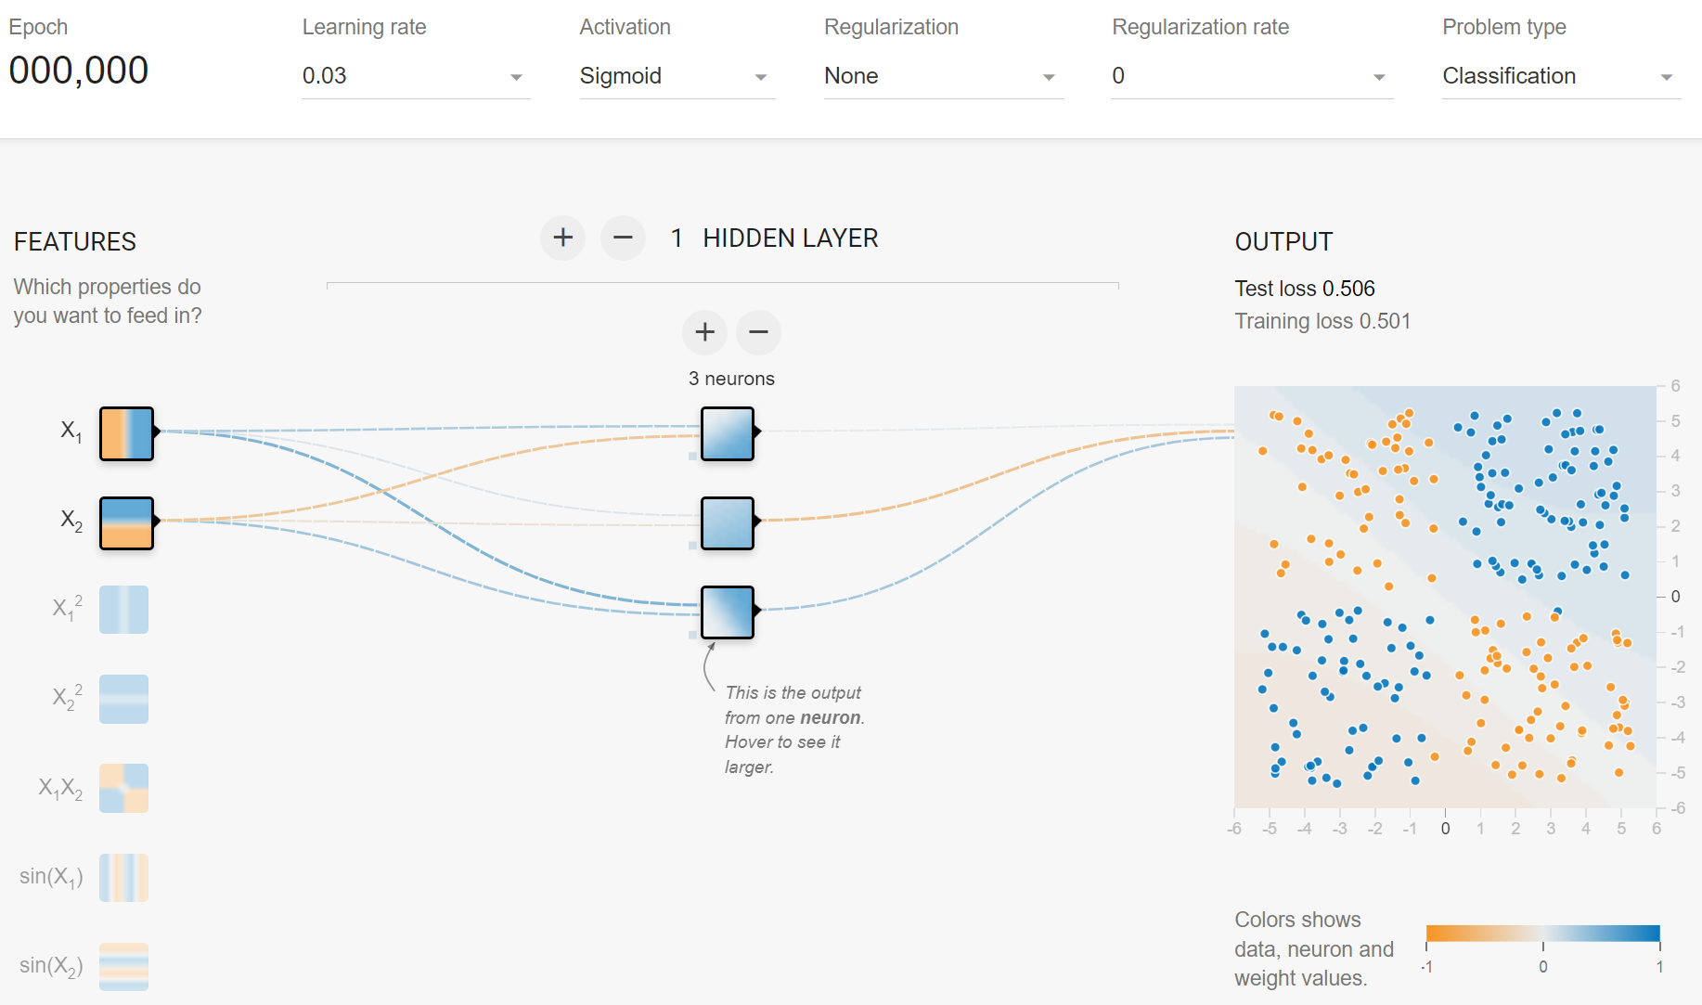
Neural network
A neural network is an architecture that consists of logistic models (ctrl-click image):
More additional logistic models can be added as nodes in the model’s first (hidden) layer, followed by a logistic regression model in the output layer.
Machine Learning Methods for Biomedical Data (D012554)
Notes:
Also convex!

Slide 21
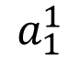
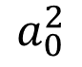
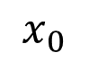
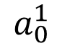
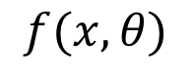
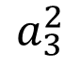
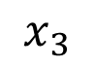
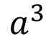
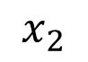
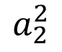
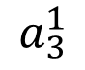
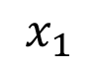
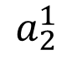
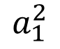
Deep neural network
A neural network is an architecture that consists of logistic models:
We can also add a second (or more) layer of nodes to the model, followed by an output layer.
$$x_{0}$$
$$a_{0}^{1}$$
$$a_{0}^{2}$$
$$x_{1}$$
$$a_{1}^{1}$$
$$a_{1}^{2}$$
$$a^{3}$$
$$f(x,θ)$$
$$x_{2}$$
$$a_{2}^{1}$$
$$a_{2}^{2}$$
$$x_{3}$$
$$a_{3}^{1}$$
$$a_{3}^{2}$$
…
…
Machine Learning Methods for Biomedical Data (D012554)
Notes:
Also convex!

Slide 22
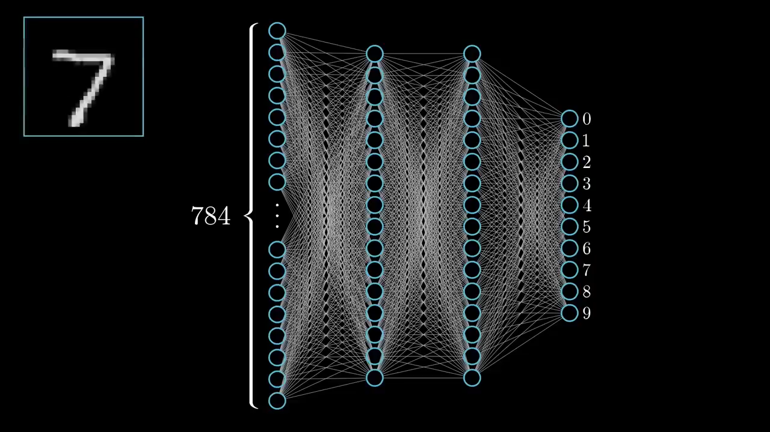
Notes:
https://www.3blue1brown.com/lessons/neural-networks

Slide 23
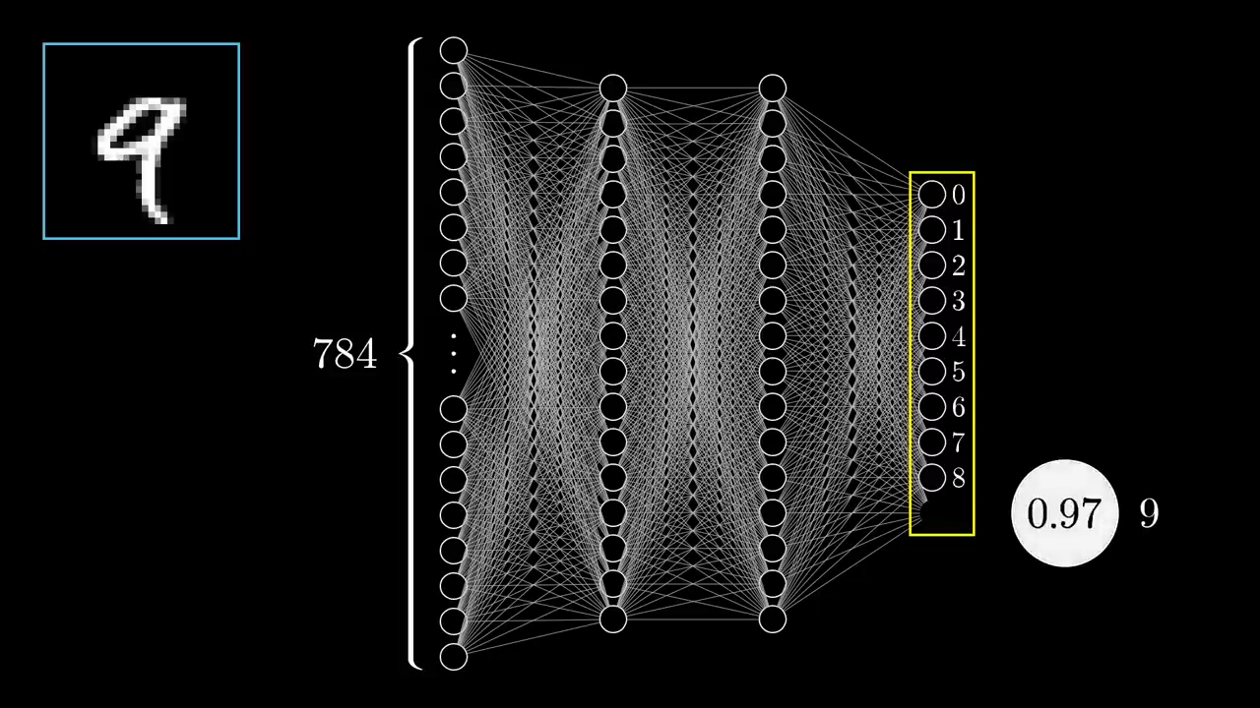

Slide 24
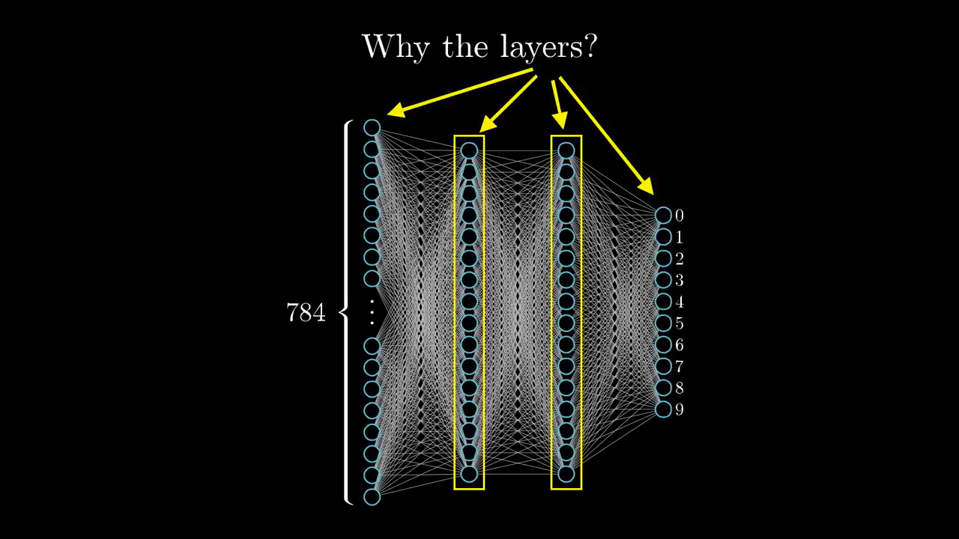

Slide 25
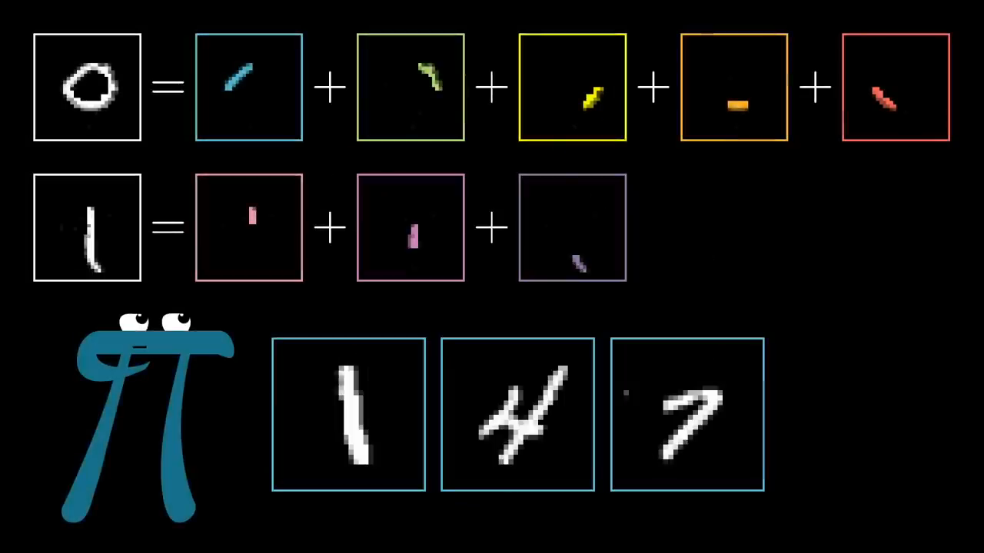

Slide 26
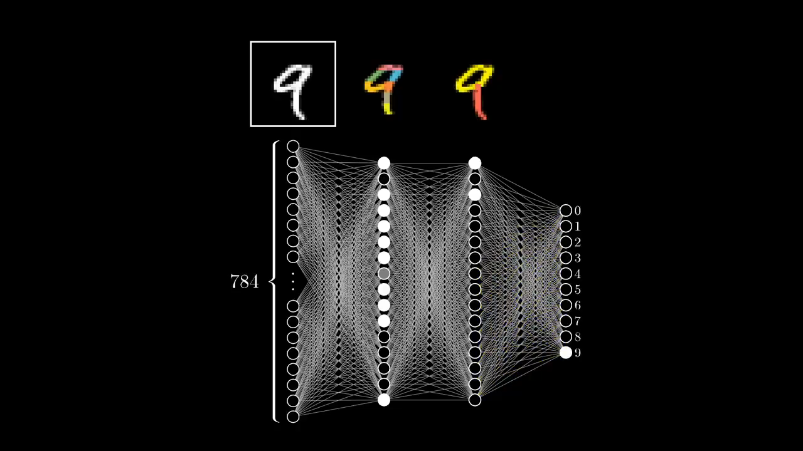

Slide 27

Neural network
A neural network is an architecture that consists of logistic models (ctrl-click image):
We can also add a second (or more) layer of nodes to the model, followed by an output layer.
Machine Learning Methods for Biomedical Data (D012554)
Notes:
Also convex!

Slide 28

Deep neural network
A neural network is somewhat similar to a decision tree.
hidden layer 1
hidden layer 2
Sethi I.K., Proceedings of the IEEE (1990)
Machine Learning Methods for Biomedical Data (D012554)
Notes:
Also convex!

Slide 29

Deep neural network
A neural network is somewhat similar to a decision tree.
Except that adding a level in a decision tree is the same as expanding the first hidden layer in a neural network. This means that neural networks can learn much more complex functions by adding hidden layers.
hidden layer 1
hidden layer 2
Sethi I.K., Proceedings of the IEEE (1990)
Machine Learning Methods for Biomedical Data (D012554)
Notes:
Also convex!

Slide 30

Deep neural network
Still not clear
Machine Learning Methods for Biomedical Data (D012554)
Notes:
Also convex!

Slide 31

x100
Machine Learning Methods for Biomedical Data (D012554)
Notes:
Also convex!

Slide 32

x10
Machine Learning Methods for Biomedical Data (D012554)
Notes:
Also convex!

Slide 33

x10
Machine Learning Methods for Biomedical Data (D012554)
Notes:
Also convex!

Slide 34

Network architecture
A neural network architecture is the structural design of an artificial neural network, defining the arrangement of layers, the number of neurons per layer, and the connections between them. It specifies how data flows through the network.
Fjodor van Veen from Asimov institute
Machine Learning Methods for Biomedical Data (D012554)
Notes:
Also convex!

Slide 35
Neural network training
Forward propagation: Input data passes through the network layer by layer, where each neuron applies weights, biases, and an activation function to compute the output.
Loss calculation: The network compares the predicted output with the actual target using a loss function to measure error.
Backpropagation: The network computes gradients of the loss with respect to weights using the chain rule of differentiation, propagating the error backward through the layers.
Weight updates: The optimizer adjusts the weights and biases using the gradients to minimize the loss, gradually improving the network's accuracy over multiple iterations (epochs).
Machine Learning Methods for Biomedical Data (D012554)
Notes:
Also convex!

Slide 36


Slide 37

https://www.youtube.com/watch?v=Ilg3gGewQ5U&t=548s&ab_channel=3Blue1Brown
Machine Learning Methods for Biomedical Data (D012554)
Notes:
Also convex!

Slide 38










Loss function
This function computes the “distance” between the output of the model and the expected output.
It defines the error the model makes.
$$x_{0}^{i}$$
$$a_{0}^{1}$$
$$x_{1}^{i}$$
$$a_{1}^{1}$$
$$x_{2}^{i}$$
$$a_{2}^{1}$$
$$a^{2}$$
$${\hat{y}}^{i}$$
$$x_{3}^{i}$$
$$a_{3}^{1}$$
…
Machine Learning Methods for Biomedical Data (D012554)
Notes:
Also convex!

Slide 39

Loss function
For a regression task we use the Mean Squared Error (MSE) also known as L2 loss.
$$\frac{1}{n}{\sum_{i=1}^{n}{(y^{i}}−{\hat{y}}^{i})}^{2}$$
$$x_{0}^{i}$$
$$a_{0}^{1}$$
$$x_{1}^{i}$$
$$a_{1}^{1}$$
$$x_{2}^{i}$$
$$a_{2}^{1}$$
$$a^{2}$$
$${\hat{y}}^{i}$$
$$x_{3}^{i}$$
$$a_{3}^{1}$$
…
Machine Learning Methods for Biomedical Data (D012554)
Notes:
Also convex!

Slide 40


Loss function
For a two-class (or binary) classification task we use the Binary Cross Entropy (BCE) loss.
$−\sum_{i=1}^{n}{(y^{i}\log\left({\hat{y}}^{i}\right)+\left(1−y^{i}\right)log⁡(1−{\hat{y}}^{i})}$)
$$x_{0}^{i}$$
$$a_{0}^{1}$$
$$x_{1}^{i}$$
$$a_{1}^{1}$$
sigmoid
$$x_{2}^{i}$$
$$a_{2}^{1}$$
$${\hat{y}}^{i}$$
$$x_{3}^{i}$$
$$a_{3}^{1}$$
…
Machine Learning Methods for Biomedical Data (D012554)
Notes:
Also convex!

Slide 41








Loss function
For a multi-class classification task we use the Categorical Cross Entropy (CE) loss.
$$−\sum_{j=1}^{C}{(y^{i}\log\left({\hat{y}}^{i}\right))}$$
$$x_{0}^{i}$$
$$a_{0}^{1}$$
softmax
$$\frac{e^{{\hat{y}}_{j}^{i}}}{\sum_{j=1}^{C}{e^{{\hat{y}}_{j}^{i}}}}$$
$$x_{1}^{i}$$
$$a_{1}^{1}$$
$${\hat{y}}_{1}^{i}$$
$${\hat{y}}_{1}^{i}$$
$$x_{2}^{i}$$
$$a_{2}^{1}$$
$${\hat{y}}_{2}^{i}$$
$${\hat{y}}_{2}^{i}$$
$$x_{3}^{i}$$
$$a_{3}^{1}$$
$${\hat{y}}_{3}^{i}$$
$${\hat{y}}_{3}^{i}$$
…
…
Machine Learning Methods for Biomedical Data (D012554)
Notes:
Also convex!

Slide 42






Loss function
For a multi-class classification task we use the Categorical Cross Entropy (CE) loss.
$$−\sum_{j=1}^{C}{(y^{i}\log\left({\hat{y}}^{i}\right))}$$
$$x_{0}^{i}$$
$$a_{0}^{1}$$
softmax
$$\frac{e^{{\hat{y}}_{j}^{i}}}{\sum_{j=1}^{C}{e^{{\hat{y}}_{j}^{i}}}}$$
$$x_{1}^{i}$$
$$a_{1}^{1}$$
$$1$$
$$0.001$$
$$x_{2}^{i}$$
$$a_{2}^{1}$$
$$2$$
$$0.002$$
$$x_{3}^{i}$$
$$a_{3}^{1}$$
$$8$$
$$0.997$$
…
…
Machine Learning Methods for Biomedical Data (D012554)
Notes:
Also convex!

Slide 43


Slide 44


Slide 45

Loss function
logistic regression (small) neural network
Machine Learning Methods for Biomedical Data (D012554)

Slide 46

Loss function
Machine Learning Methods for Biomedical Data (D012554)

Slide 47

Stochastic gradient descent (SGD)
Gradient descent (GD) takes into consideration the complete training dataset through every iteration, which may become time-consuming and computationally expensive.
GD may converge to a local minimum and may not be able to get away from it.
SGD takes into consideration one random data point through every iteration, which may lead to noisier results than the GD and may allow escaping local minima.
Machine Learning Methods for Biomedical Data (D012554)
Notes:
Advanced: https://www.youtube.com/watch?v=Ilg3gGewQ5U&ab_channel=3Blue1Brown

Slide 48

Mini batch gradient descent
Mini batch gradient descent is a cross-over between GD and SGD. Instead of iterating through the entire dataset (GD) or one observation (SGD), we split the dataset into small subsets (mini batches) and compute the gradients for each batch.
Machine Learning Methods for Biomedical Data (D012554)
Notes:
Advanced: https://www.youtube.com/watch?v=Ilg3gGewQ5U&ab_channel=3Blue1Brown

Slide 49

Momentum in SGD
Instead of updating parameters solely based on the current gradient, momentum accumulates past gradients, allowing the optimizer to maintain direction and overcome local minima more efficiently.
Momentum introduces a velocity vector, which is an exponentially weighted moving average of past gradients, helping to smooth updates and accelerate training in consistent directions.
Imagine rolling down a ball inside of a frictionless bowl. Instead of stopping at the bottom, the momentum it has accumulated pushes it forward, and the ball keeps rolling back and forth.
Machine Learning Methods for Biomedical Data (D012554)
Notes:
Advanced: https://www.youtube.com/watch?v=Ilg3gGewQ5U&ab_channel=3Blue1Brown

Slide 50

Momentum in SGD
Instead of updating parameters solely based on the current gradient, momentum accumulates past gradients, allowing the optimizer to maintain direction and overcome local minima more efficiently.
Momentum introduces a velocity vector, which is an exponentially weighted moving average of past gradients, helping to smooth updates and accelerate training in consistent directions.
Imagine rolling down a ball inside of a frictionless bowl. Instead of stopping at the bottom, the momentum it has accumulated pushes it forward, and the ball keeps rolling back and forth.
Machine Learning Methods for Biomedical Data (D012554)
Notes:
An Exponentially Weighted Moving Average is a way to smooth a sequence of values (like gradients, temperatures, or stock prices), giving more importance to recent values while not completely ignoring older ones.
It’s called:
"Moving Average" because it averages over time.
"Exponentially Weighted" because older values are given exponentially less weight.

Slide 51

Adaptive Learning Rates
AdaGrad adjusts the learning rate individually for each feature, reducing it over time based on the cumulative sum of past squared gradients. This helps features with smaller gradients (e.g., sparse features) receive relatively larger updates.
Adam optimizer blends momentum (to smooth updates) and adaptive learning rates (to scale updates per parameter), making it well-suited for noisy gradients and sparse features while maintaining efficient convergence.
Machine Learning Methods for Biomedical Data (D012554)
Notes:
Advanced: https://www.youtube.com/watch?v=Ilg3gGewQ5U&ab_channel=3Blue1Brown

Slide 52

Neural network
mnist_pytorch.ipynb
Machine Learning Methods for Biomedical Data (D012554)

Slide 53


Slide 54

Notes:
It found a happy local minimum

Slide 55


